Slide 1
Child Passenger Safety Around North Carolina

Slide 2
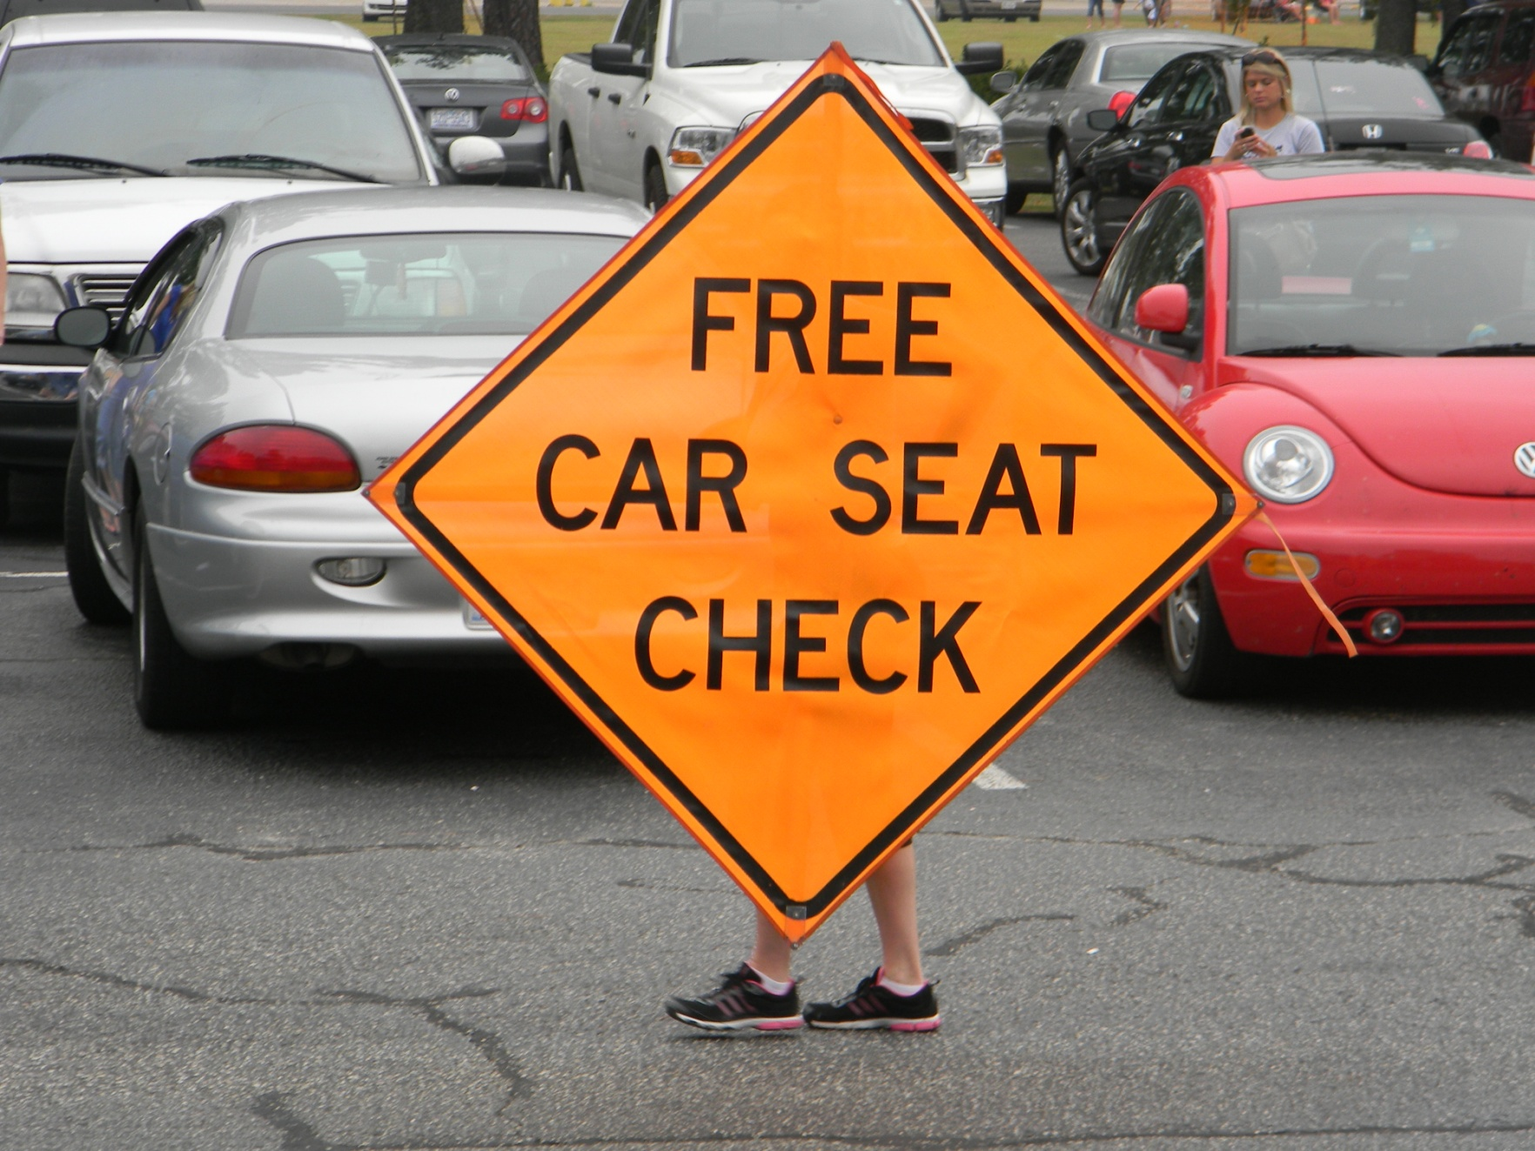
Columbus County

Slide 3
Western North Carolina

Slide 4
Rockingham County

Slide 5
Caldwell County

Slide 6
Duplin County

Slide 7
Robeson County

Slide 8
Durham, NC Museum of Life and Science

Slide 9
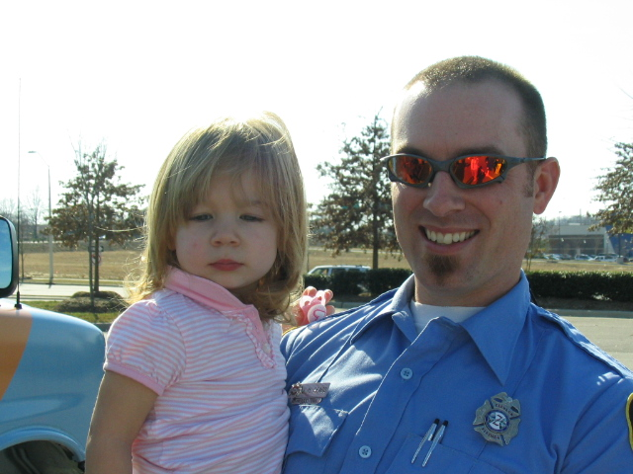
Wake County

Slide 10
Henderson, Vance County

Slide 11
Western North Carolina

Slide 12
Safe Kids Exhibit, North Carolina State Fair

Slide 13
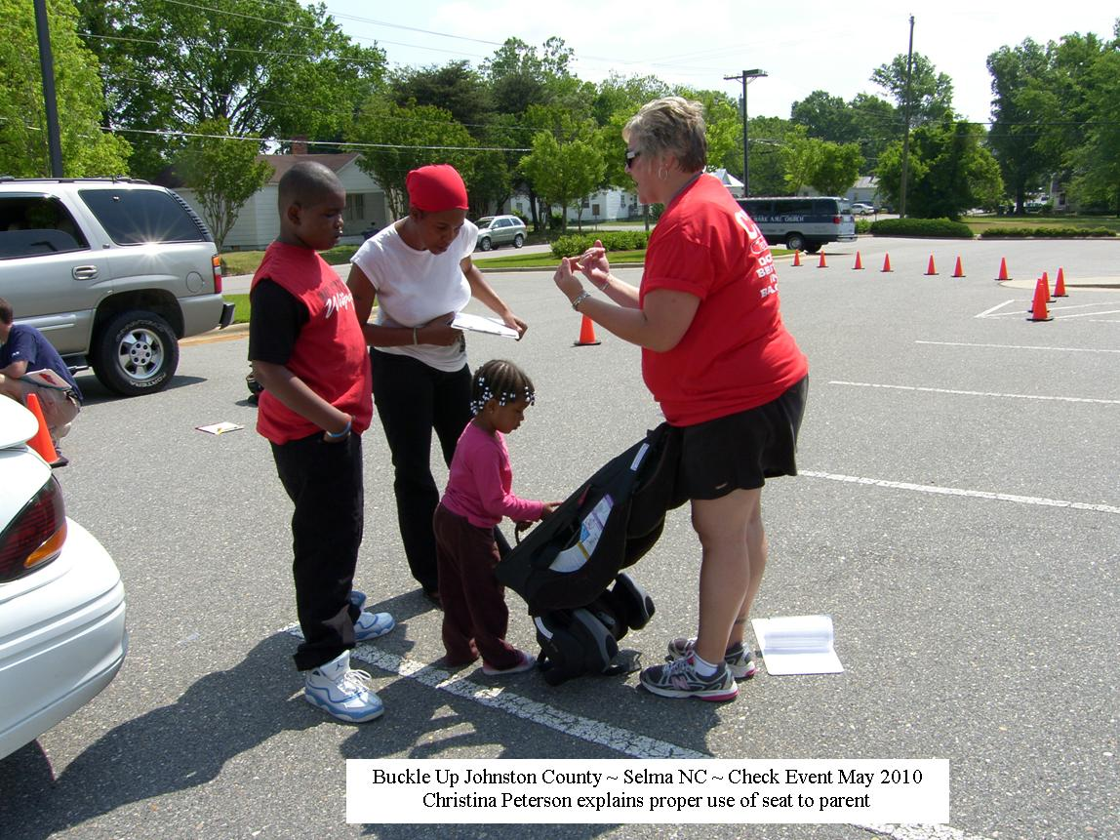
Johnston County

Slide 14
Rockingham County

Slide 15
Cabarrus County

Slide 16
Buncombe County

Slide 17
Rocky Mount Fire Department

Slide 18
High Point, NC Permanent Checking Station

Slide 19
Pitt County

Slide 20
Fayetteville, NC

Slide 21
Western North Carolina

Slide 22
Safe Kids Exhibit, North Carolina State Fair

Slide 23
Caldwell County

Slide 24
High Point, NC Permanent Checking Station

Slide 25
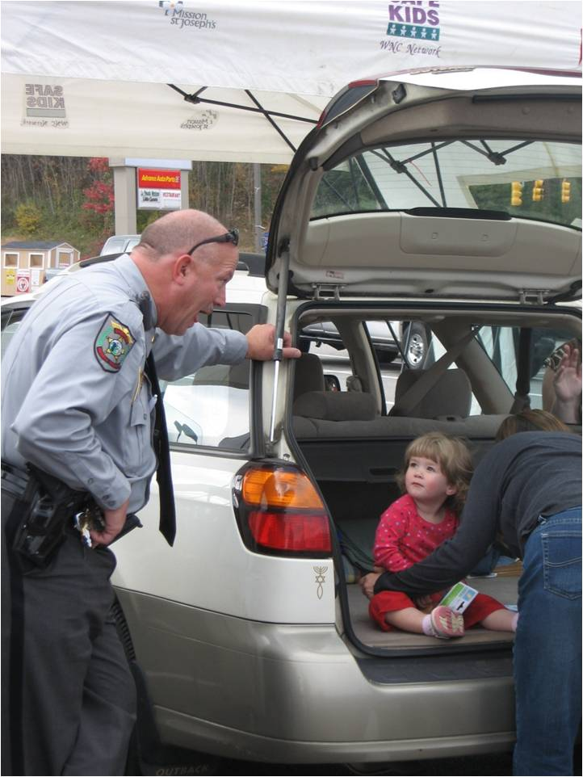
Buncombe County

Slide 26
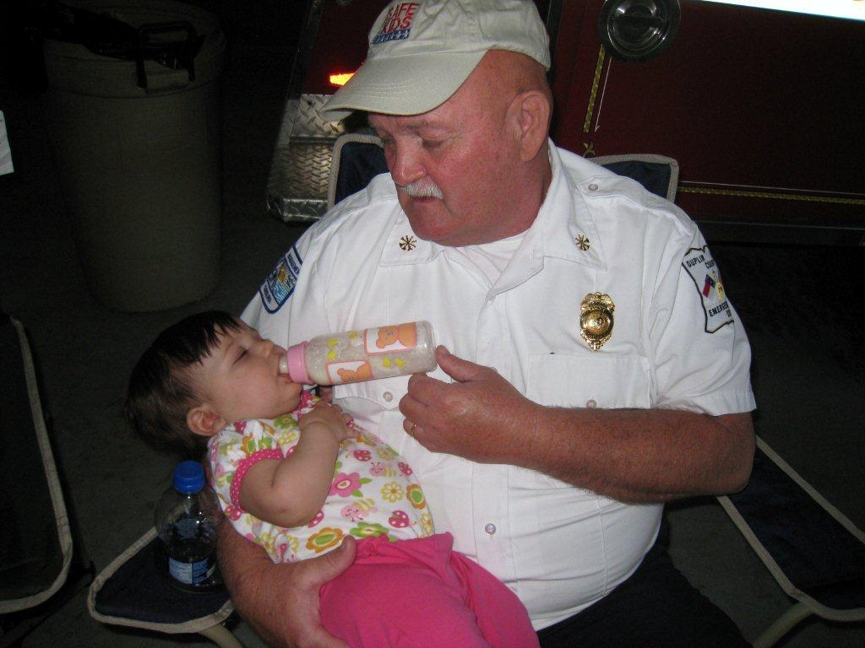
Duplin County

Slide 27
Britax Permanent Checking Station, Charlotte NC

Slide 28
Zebulon, NC Carolina MudCats

Slide 29
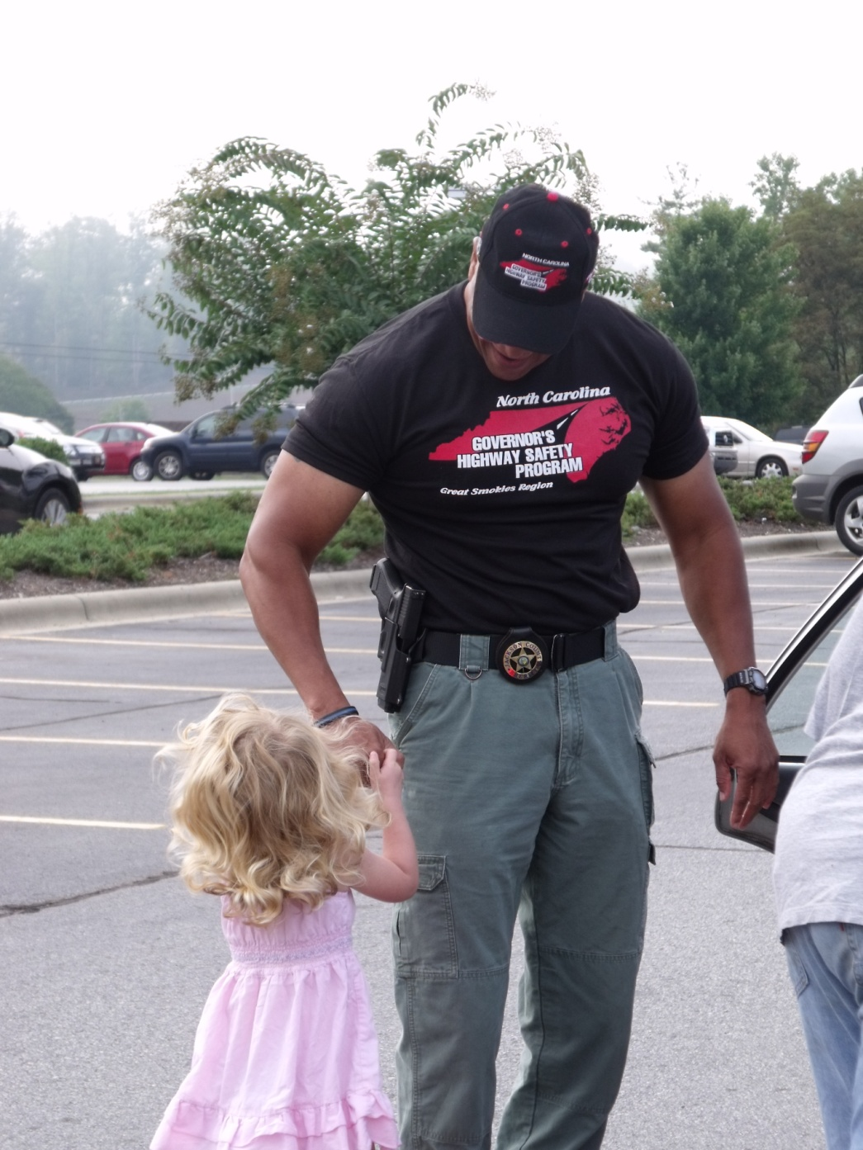
Buncombe County

Slide 30
Pitt County

Slide 31
Robeson County

Slide 32
Rockingham County

Slide 33
Britax Permanent Checking Station, Charlotte NC

Slide 34
Fayetteville, NC

Slide 35
Pitt County

Slide 36
Matthews Police Department, Mecklenburg County

Slide 37
Rockingham County

Slide 38
Safe Kids Exhibit, North Carolina State Fair

Slide 39
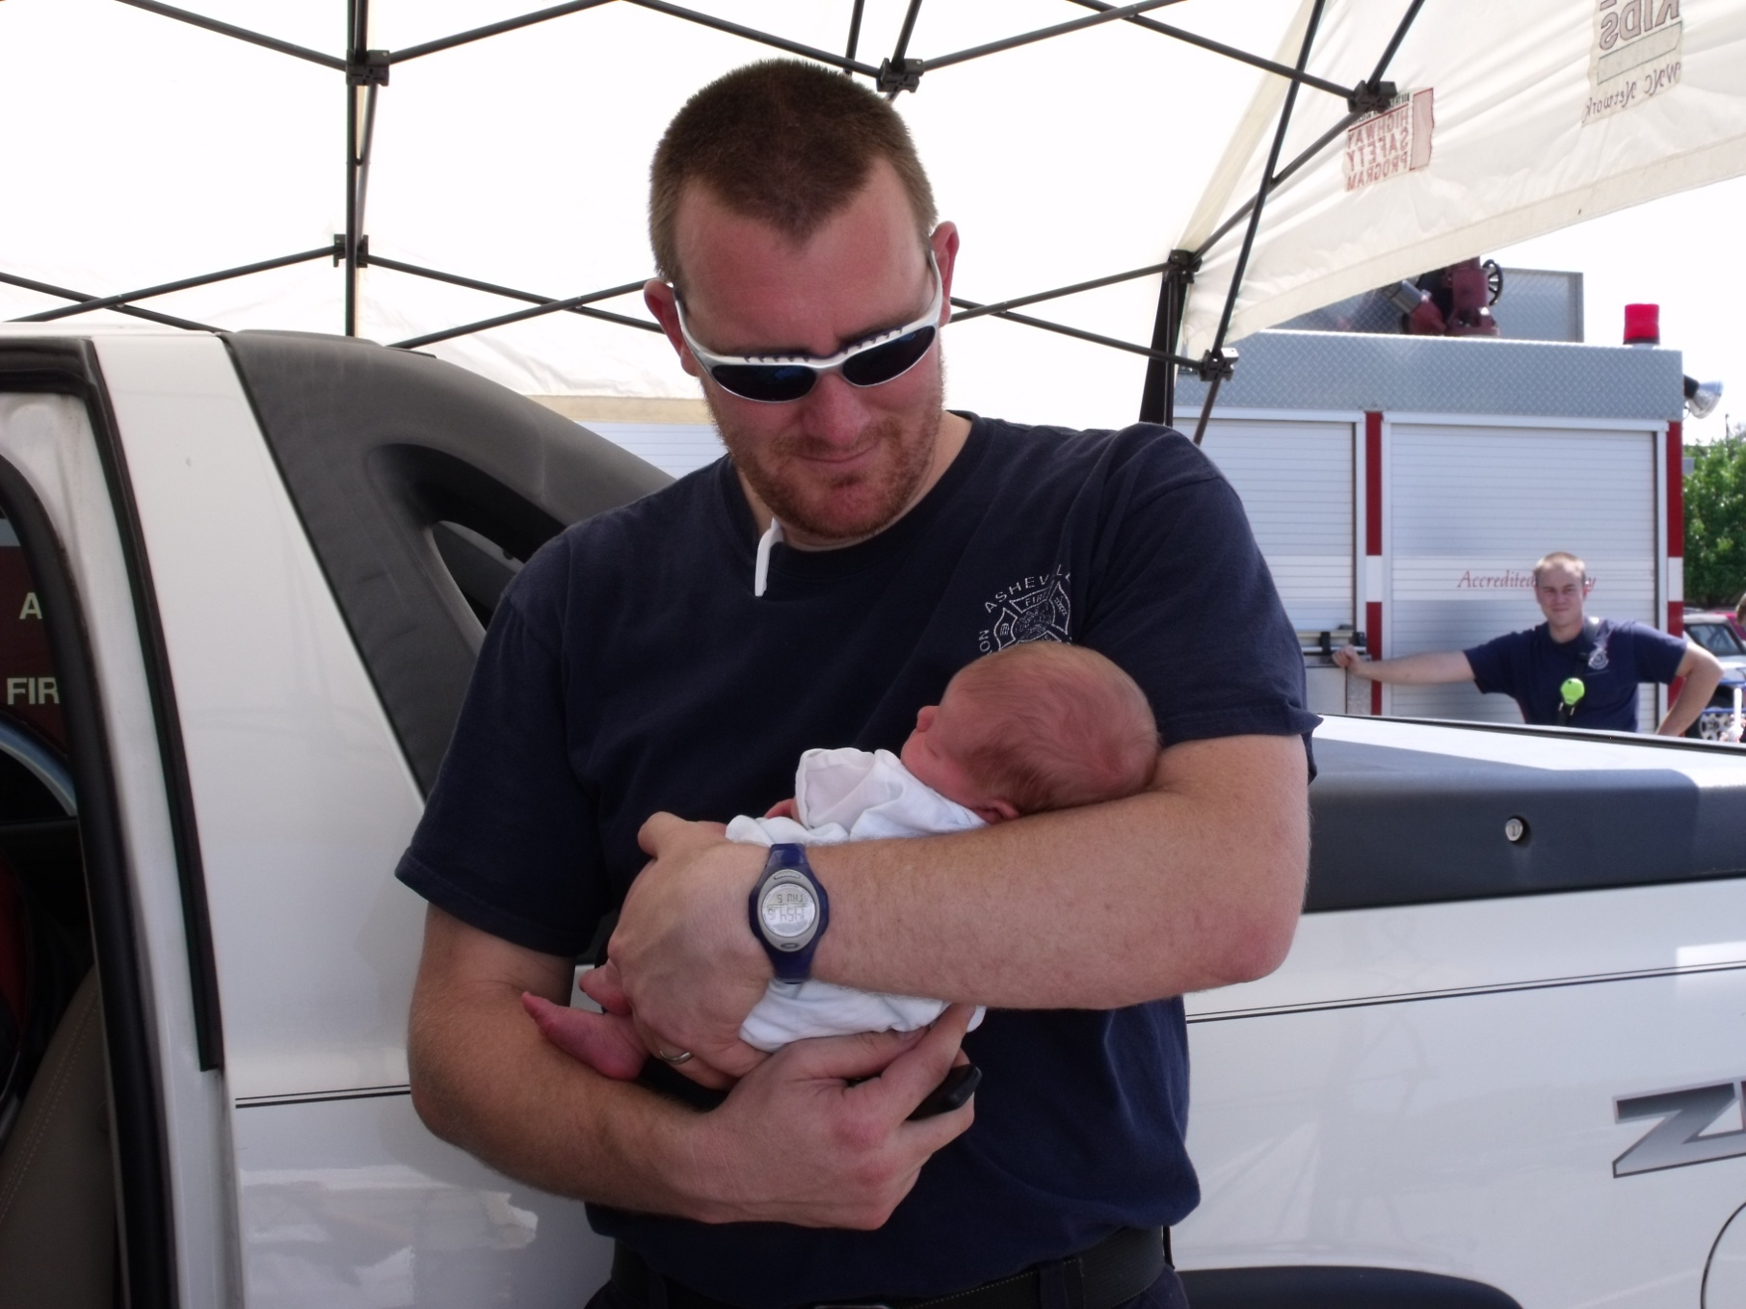
Buncombe County

Slide 40
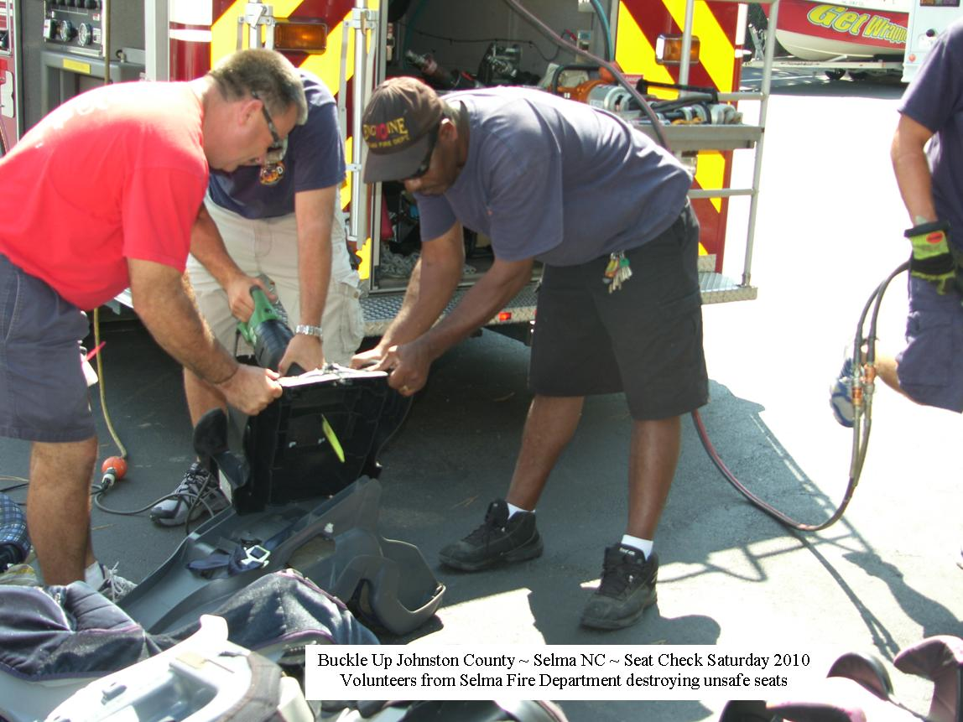
Johnston County

Slide 41
Britax Permanent Checking Station, Charlotte NC

Slide 42
Safe Kids Exhibit, North Carolina State Fair

Slide 43
Rocky Mount Fire Department

Slide 44
Henderson, Vance County

Slide 45
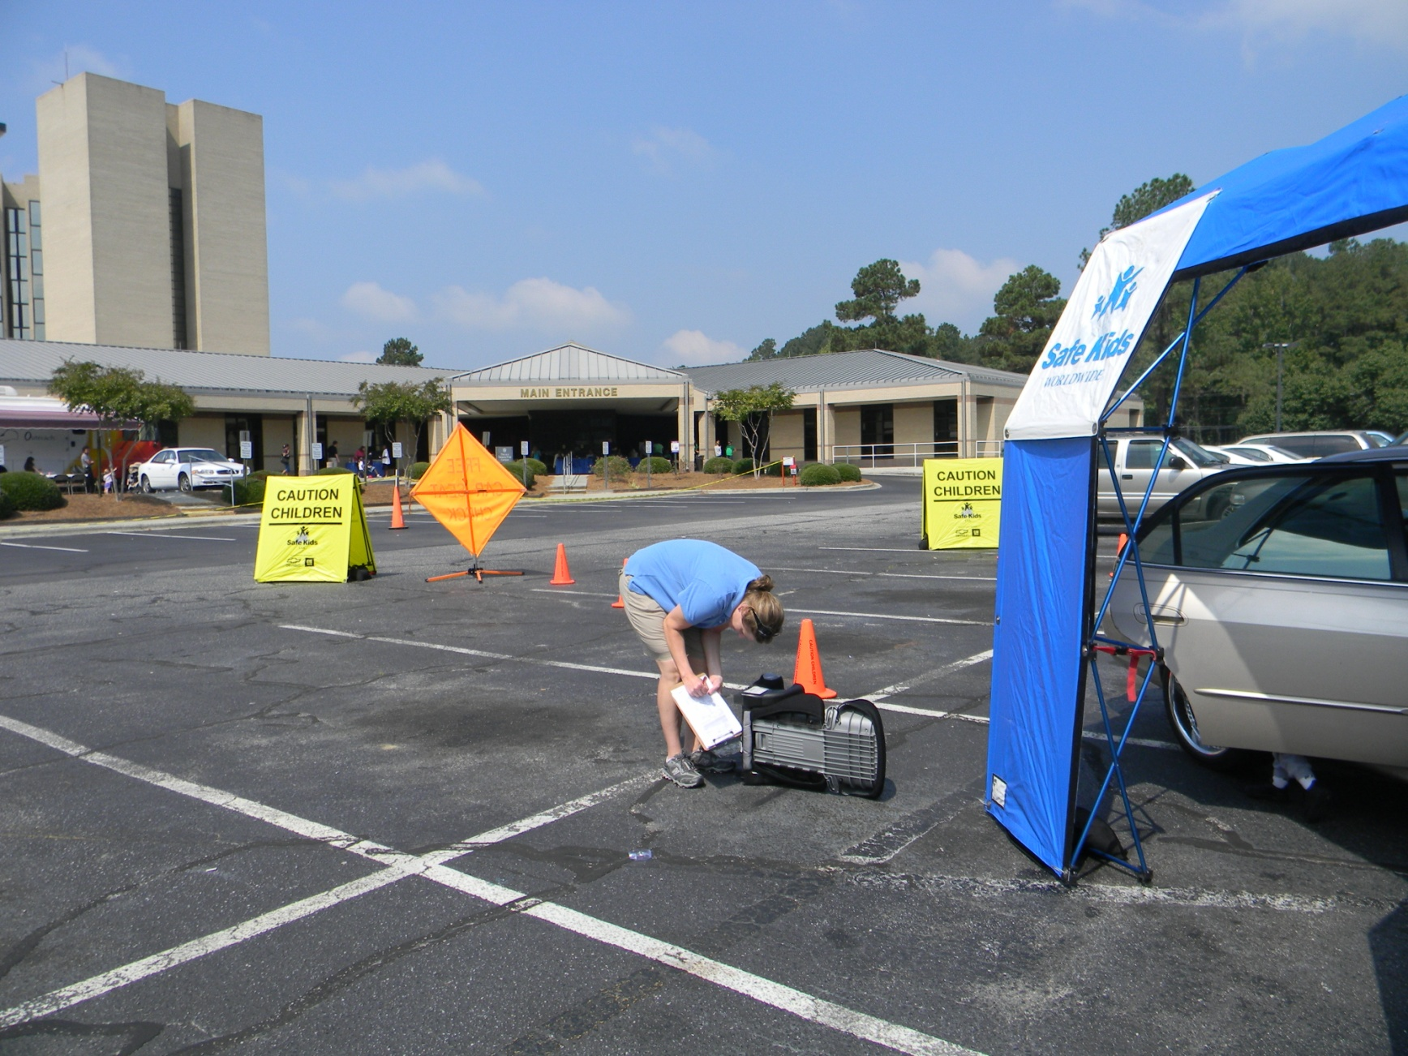
Columbus County

Slide 46
Robeson County

Slide 47
Rocky Mount Fire Department

Slide 48
Rockingham County

Slide 49
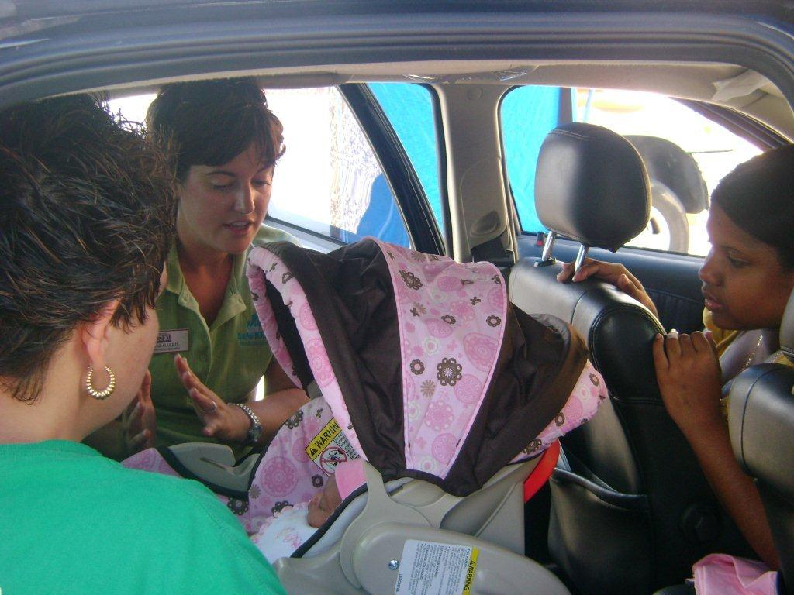
Duplin County

Slide 50
Western North Carolina

Slide 51
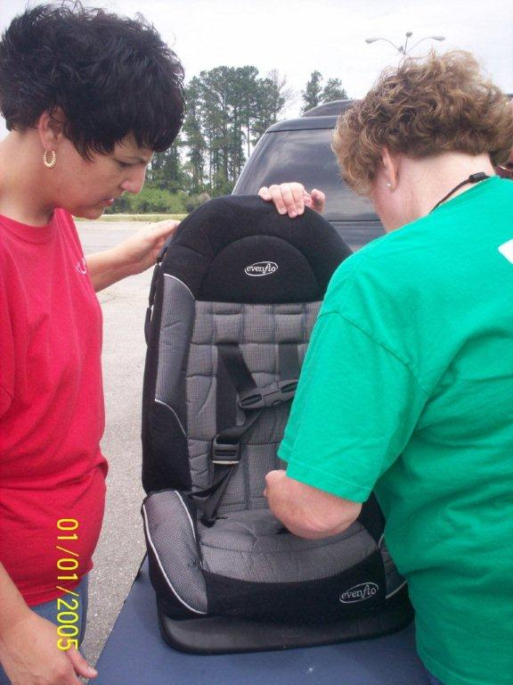
Duplin County

Slide 52
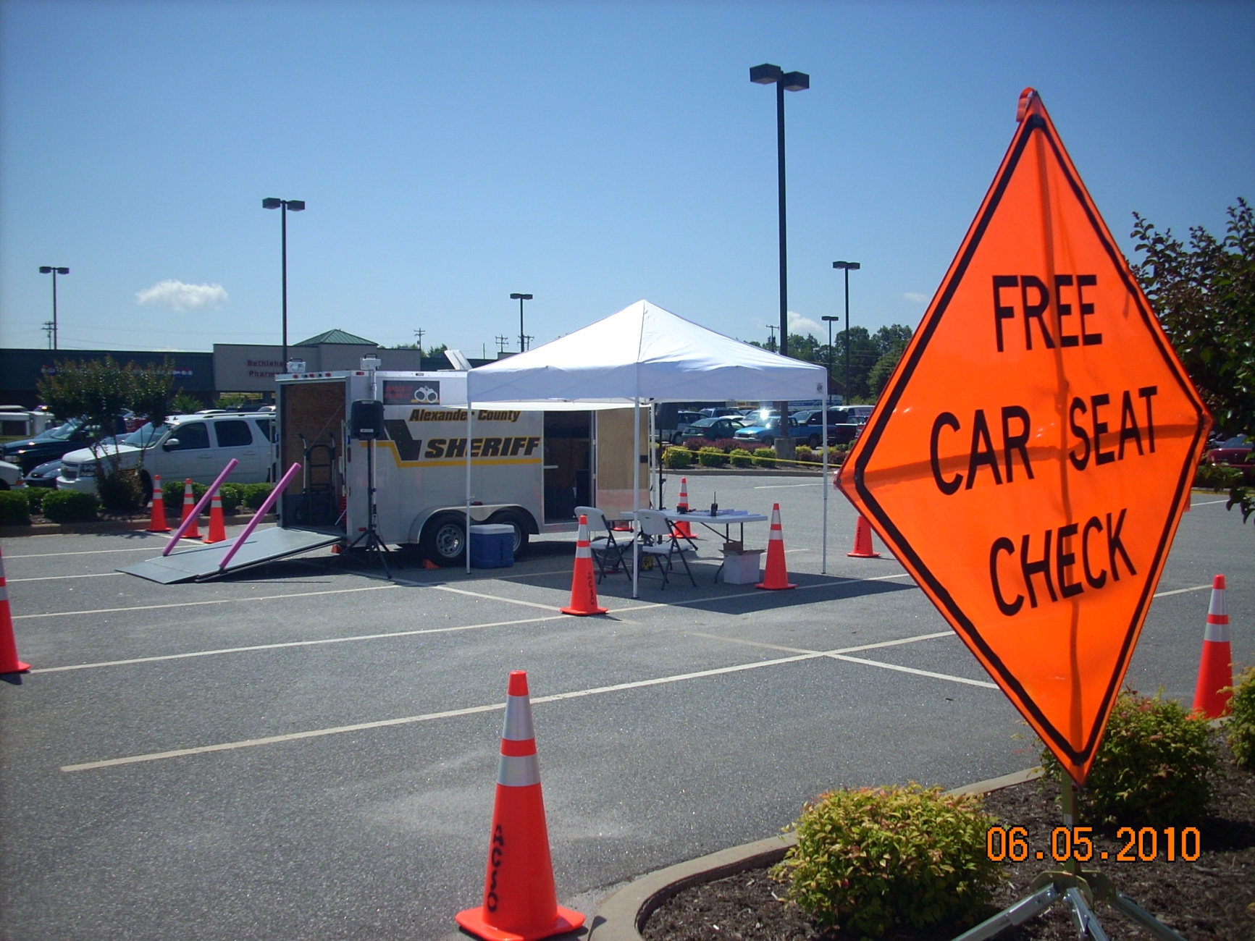
Alexander County

Slide 53
Rocky Mount Fire Department

Slide 54
Surry County

Slide 55
Robeson County

Slide 56
Rocky Mount Fire Department

Slide 57
Wake County

Slide 58
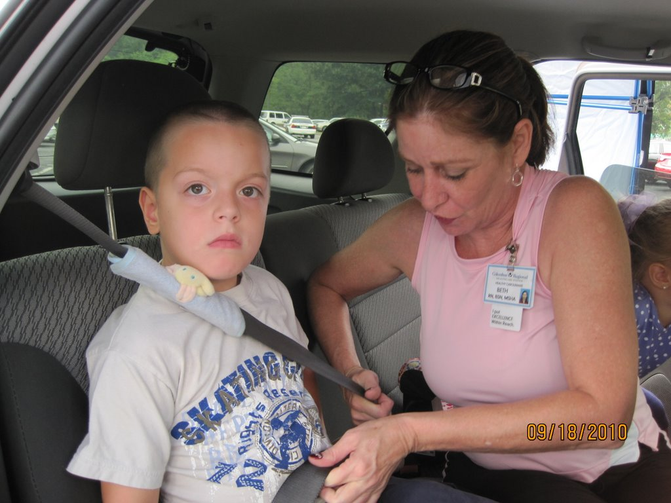
Columbus County

Slide 59
Caldwell County

Slide 60
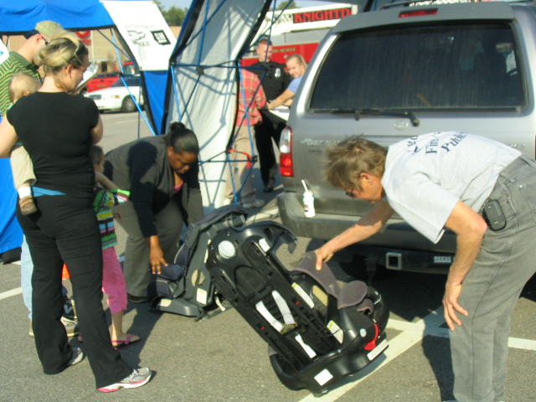
Wake County

Slide 61
Robeson County

Slide 62
Safe Kids Exhibit, North Carolina State Fair

Slide 63
Durham, NC Museum of Life and Science

Slide 64
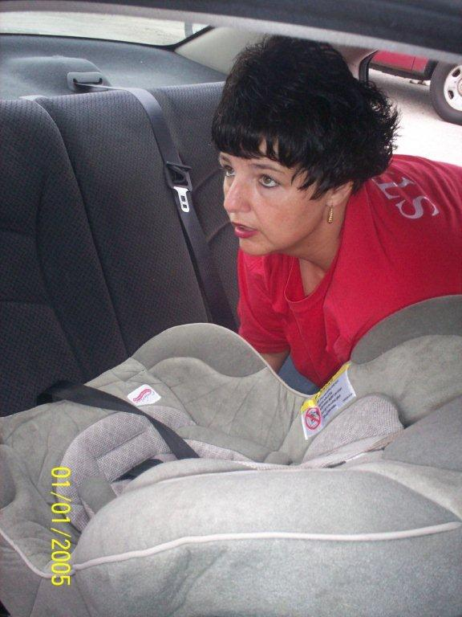
Duplin County

Slide 65
Wake County

Slide 66
Fayetteville, NC

Slide 67
Fayetteville, NC

Slide 68
Durham, NC Museum of Life and Science

Slide 69
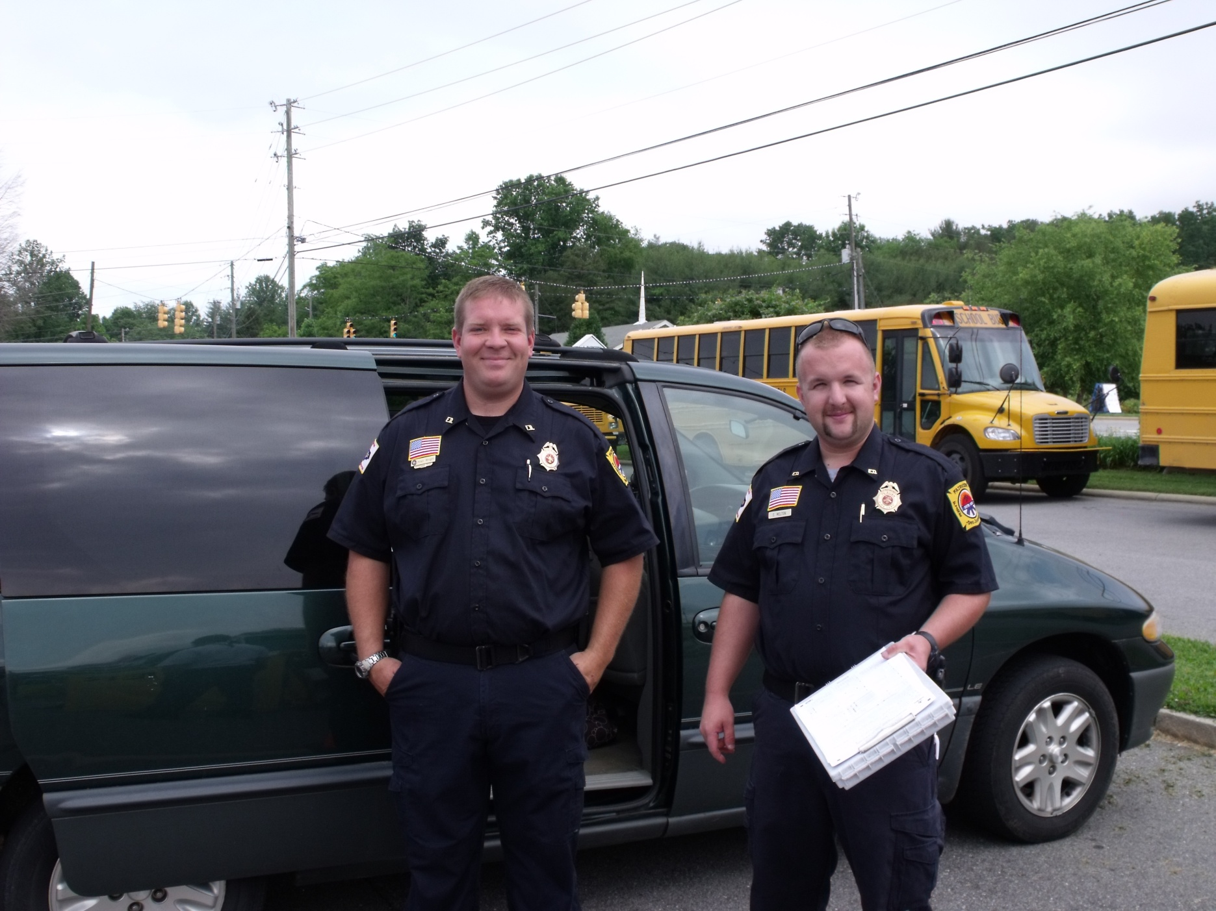
Buncombe County

Slide 70
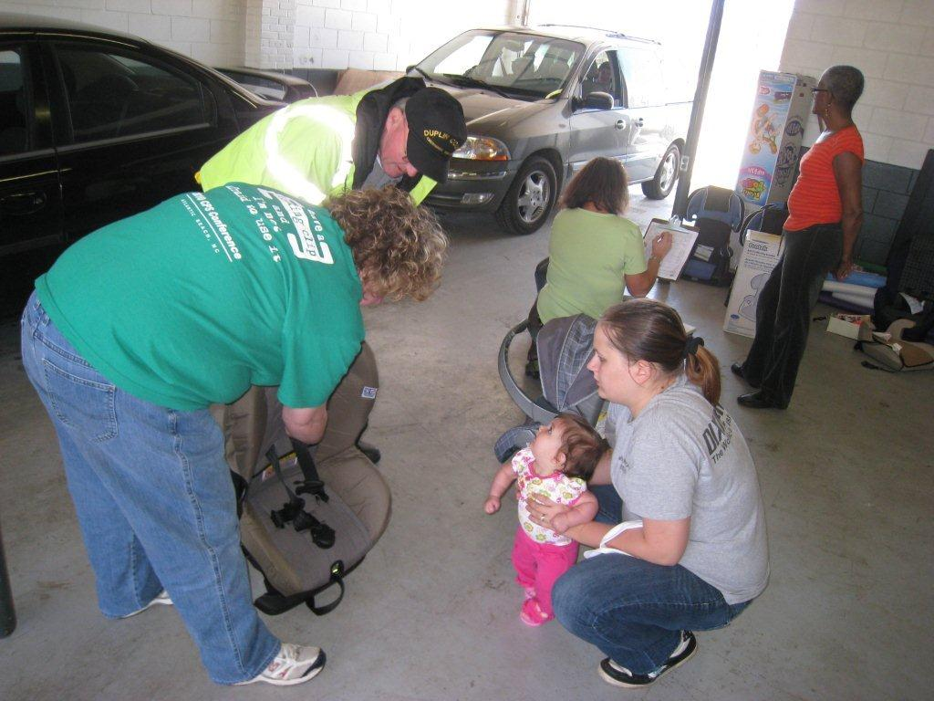
Duplin County

Slide 71
Safe Kids Exhibit, North Carolina State Fair

Slide 72
Caldwell County

Slide 73
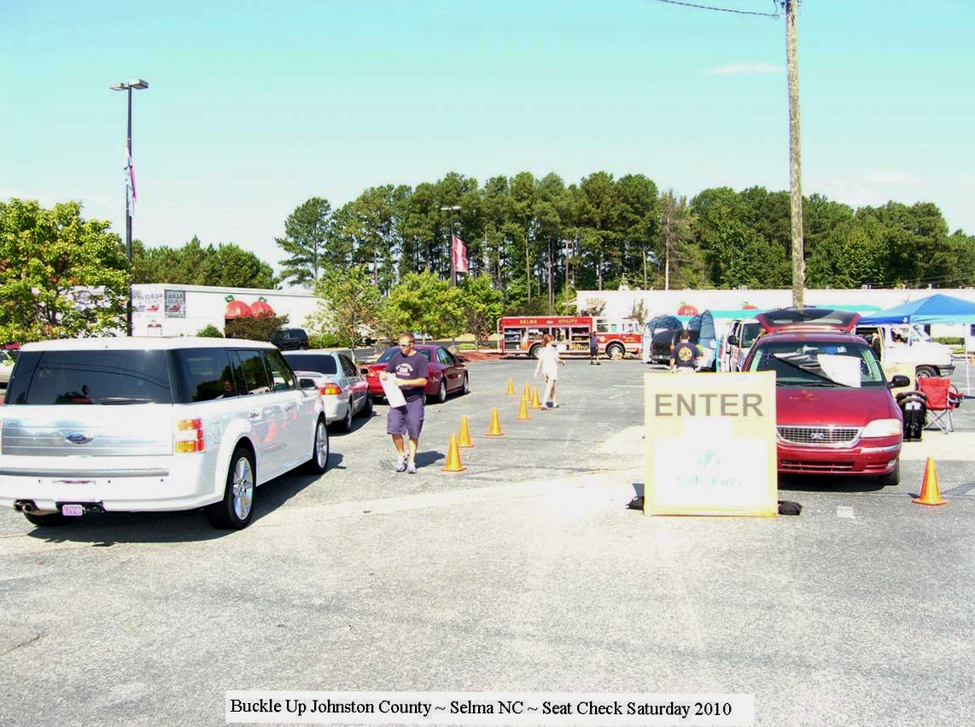
Johnston County

Slide 74
Robeson County

Slide 75
Britax Permanent Checking Station, Charlotte NC

Slide 76
Safe Kids Exhibit, North Carolina State Fair

Slide 77
Caldwell County

Slide 78
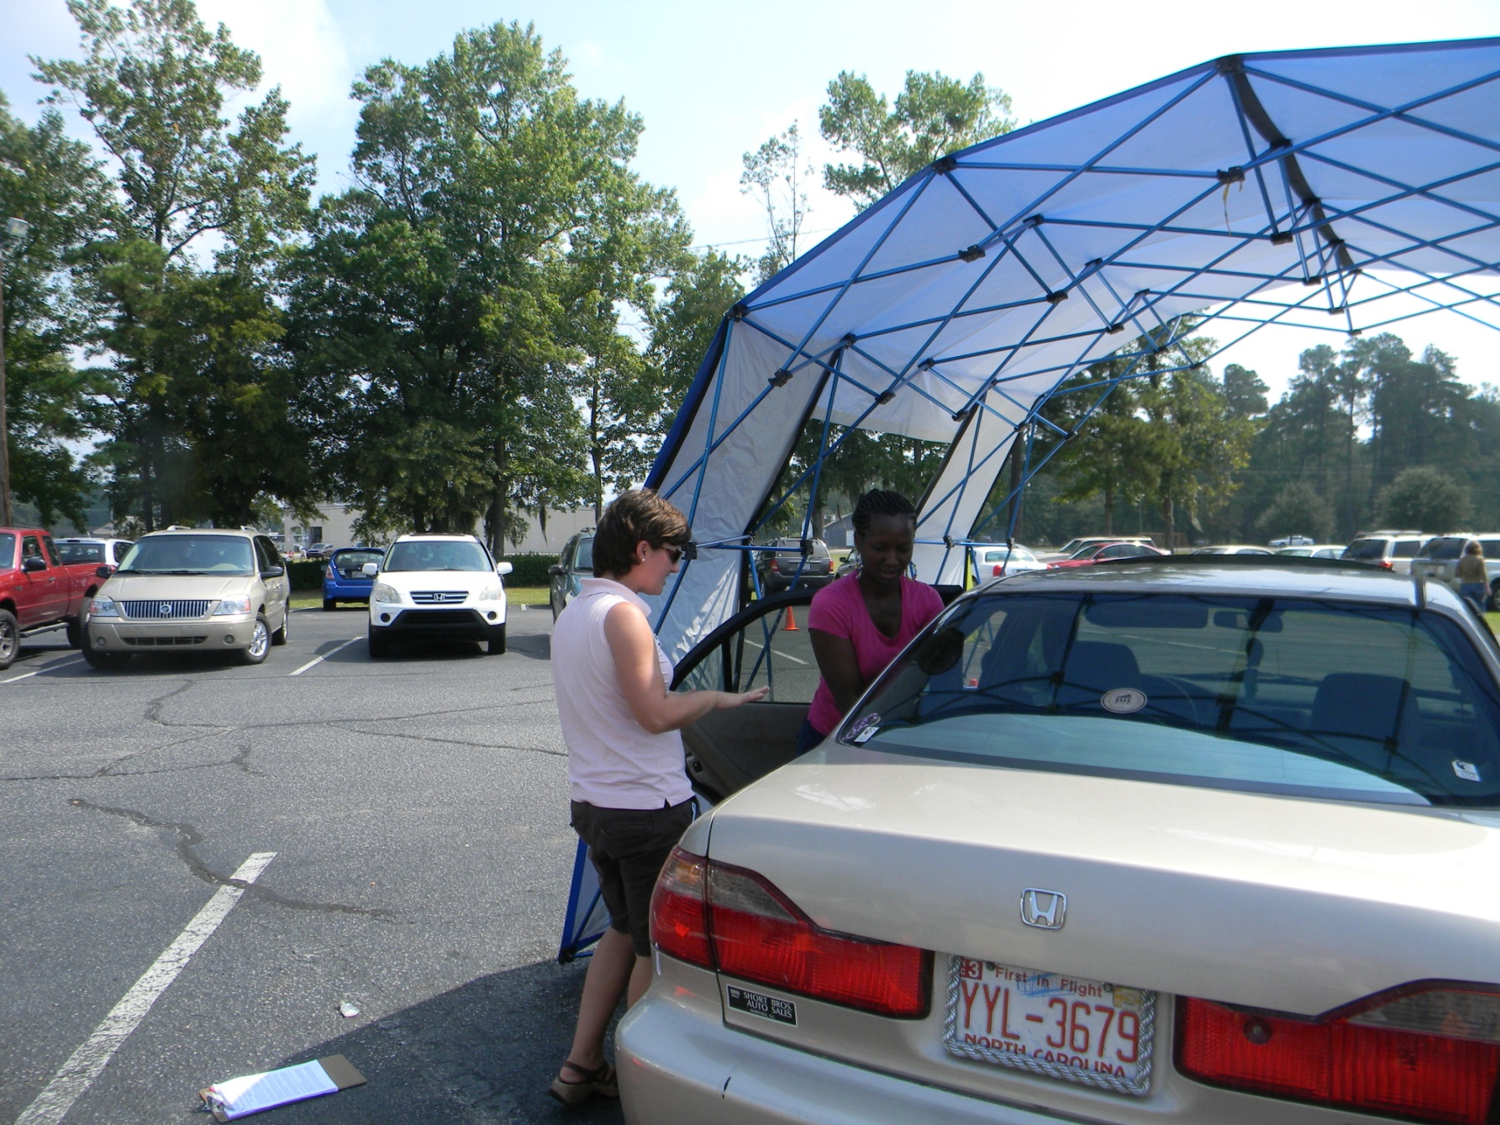
Columbus County

Slide 79
Fayetteville, NC

Slide 80
Henderson, Vance County

Slide 81
Pitt County

Slide 82
Durham, NC Museum of Life and Science

Slide 83
Rockingham County

Slide 84
Rockingham County

Slide 85
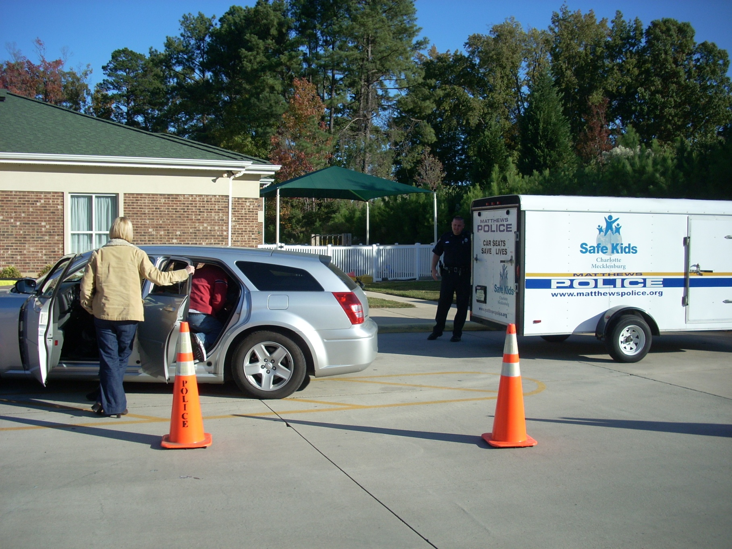
Matthews Police Department, Mecklenburg County

Slide 86
Cabarrus County

Slide 87
Wake County

Slide 88
Cabarrus County

Slide 89
Matthews Police Department, Mecklenburg County

Slide 90
Durham County

Slide 91
Matthews Police Department, Mecklenburg County

Slide 92
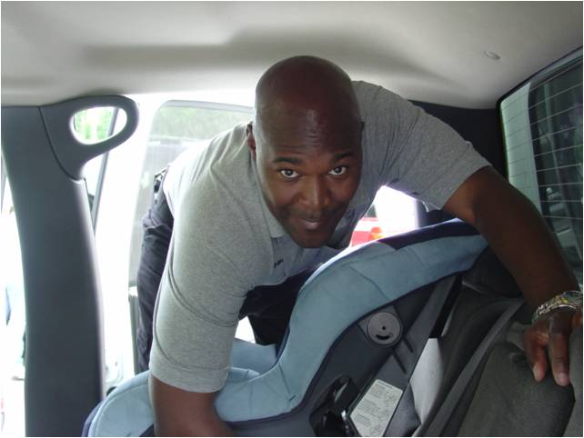
Buncombe County

Slide 93
Surry County

Slide 94
Britax Permanent Checking Station, Charlotte NC

Slide 95
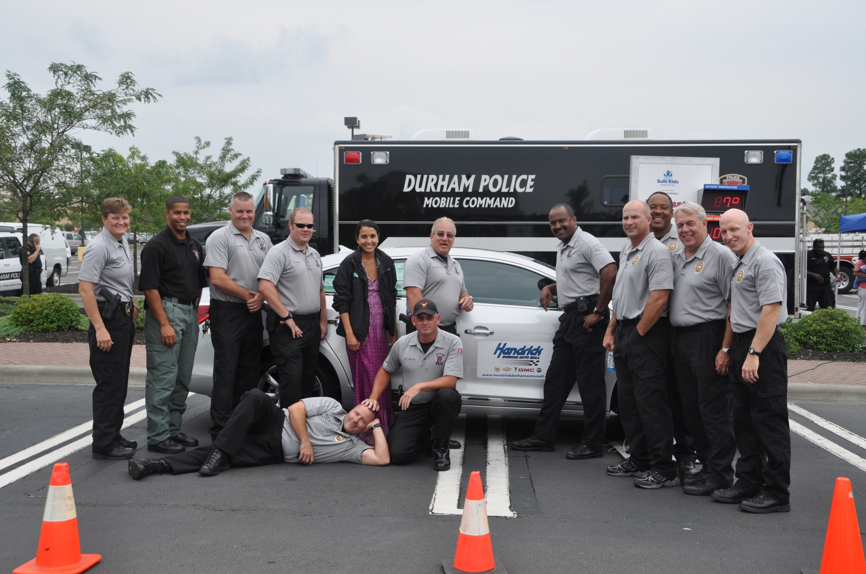
Durham County

Slide 96
Wake County

Slide 97
Rockingham County

Slide 98
Zebulon, NC Carolina MudCats

Slide 99
Rockingham County

Slide 100
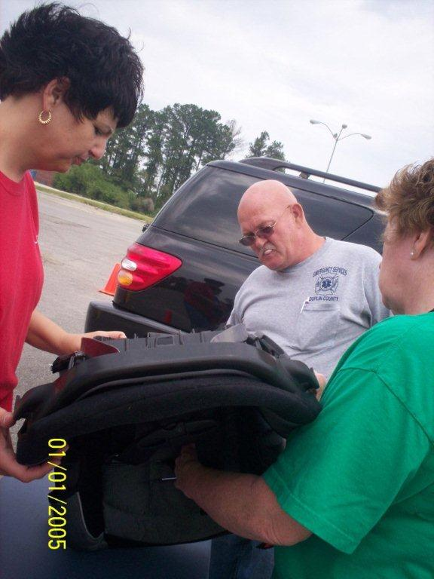
Duplin County

Slide 101
Henderson, Vance County

Slide 102
Rockingham County

Slide 103
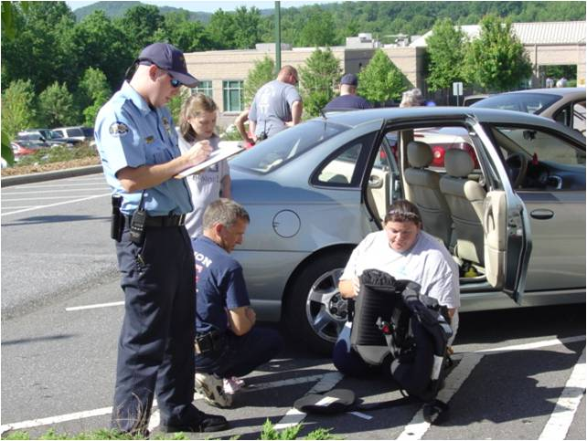
Buncombe County

Slide 104
Western North Carolina

Slide 105
Rocky Mount Fire Department

Slide 106
Western North Carolina

Slide 107
High Point, NC Permanent Checking Station

Slide 108
Rockingham County

Slide 109
Wake County

Slide 110
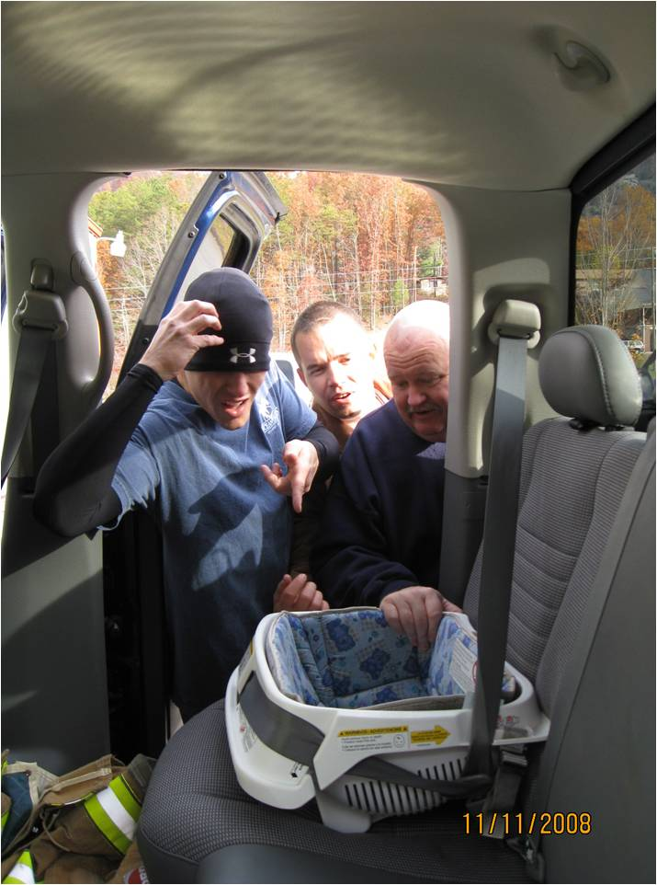
Buncombe County

Slide 111
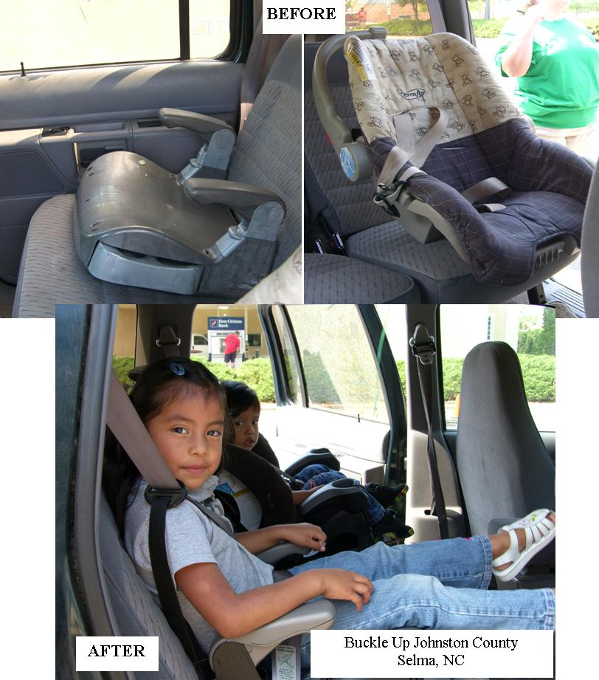
Johnston County

Slide 112
Britax Permanent Checking Station, Charlotte NC

Slide 113
Pitt County

Slide 114
Fayetteville, NC

Slide 115
Buncombe County

Slide 116
Wake County

