Slide 1
Award Winners

Slide 2
Child Passenger Safety Technician of the Year

Slide 3
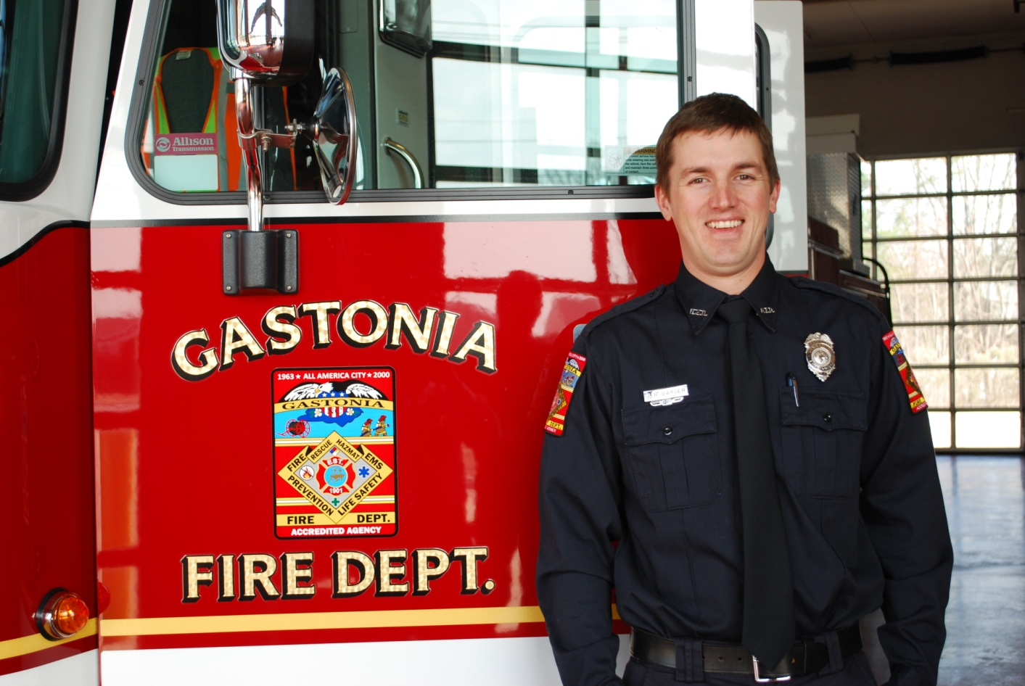
Child Passenger Safety Technician of the Year
John Barger, Gastonia Fire Department

Slide 4
Child Passenger Safety Technician Instructor of the Year

Slide 5
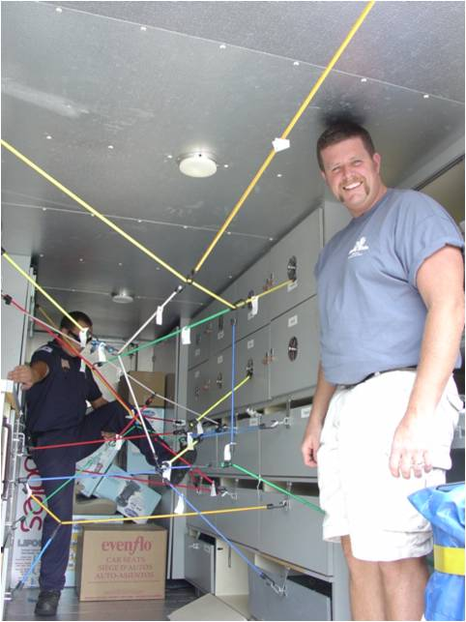
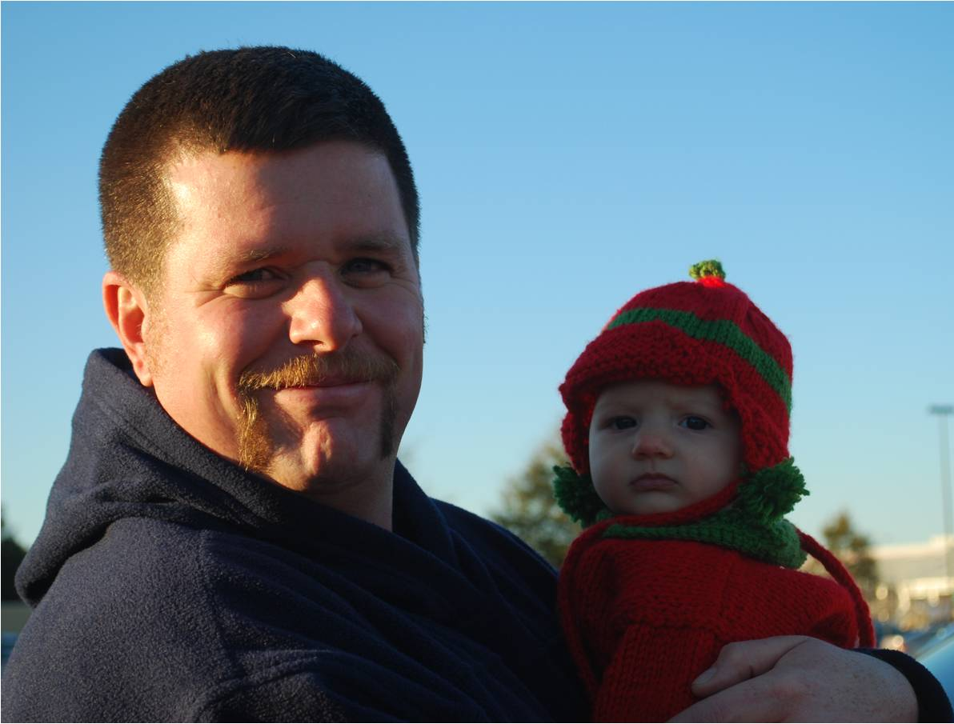
Child Passenger Safety Technician Instructor of the Year
Mark Dillingham, Skyland Fire & Rescue

Slide 6
Child Passenger Safety Program of the Year

Slide 7
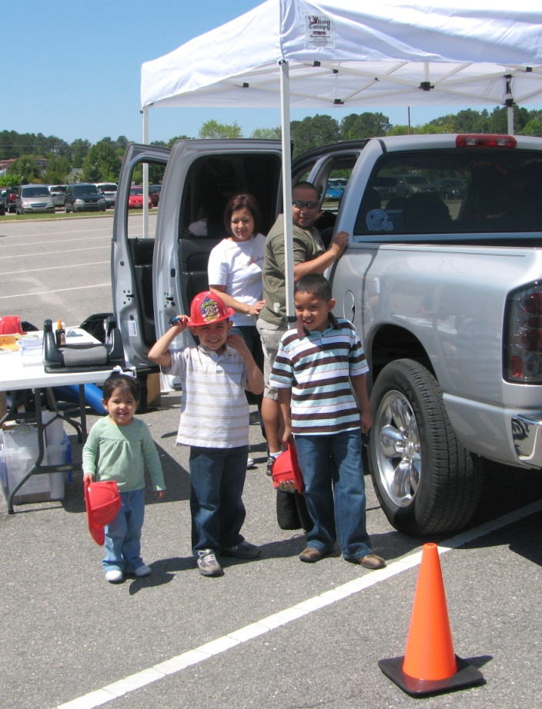
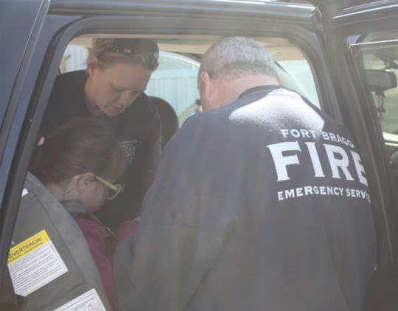
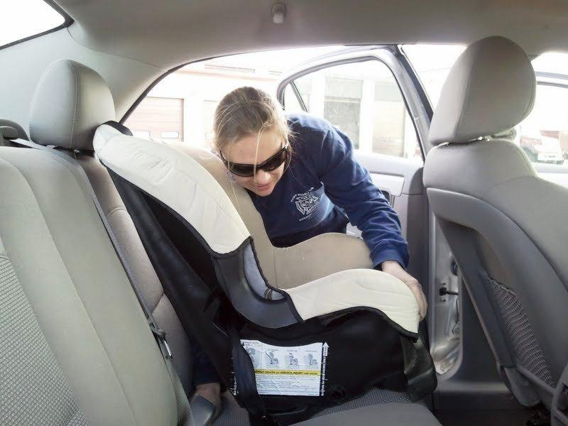
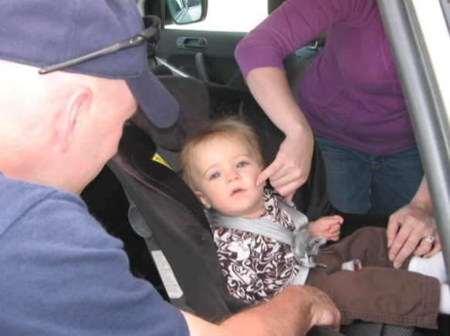
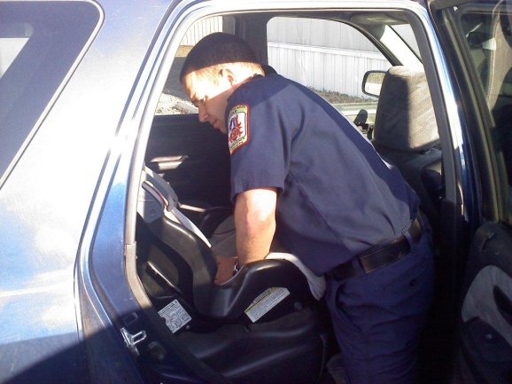
Child Passenger Safety Program of the Year
Fort Bragg Fire & Emergency Services

Slide 8
CPS Saves

Slide 9
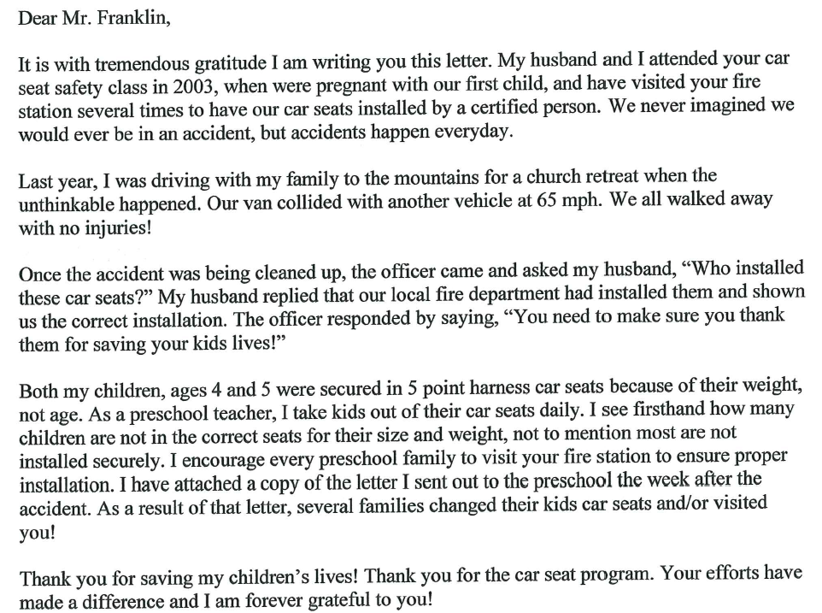
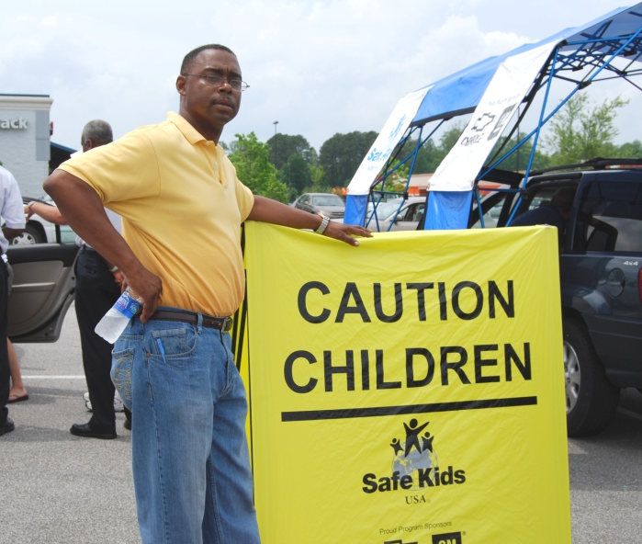
CPS Save
Norman Franklin, Concord Fire Department

Slide 10
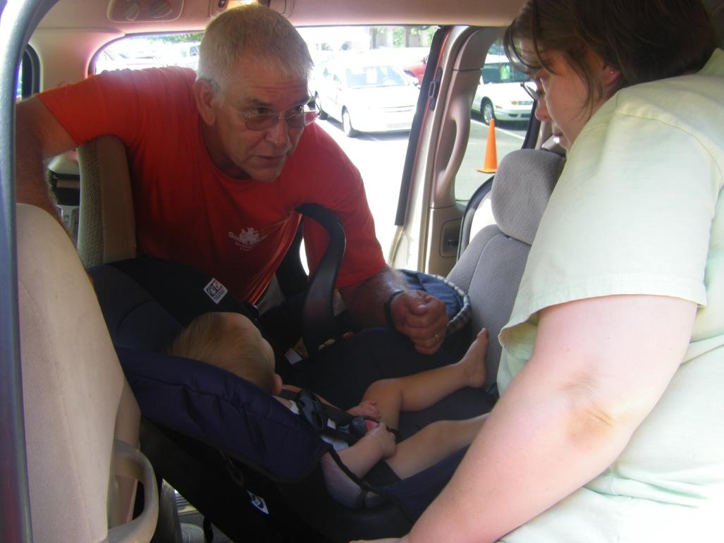
CPS Save
Gene Brown, Reidsville Fire Department

Slide 11
Bill Hall Lifetime Achievement Award

Slide 12
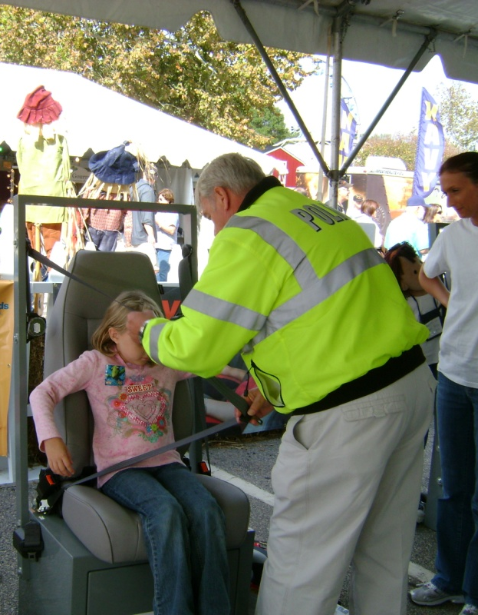
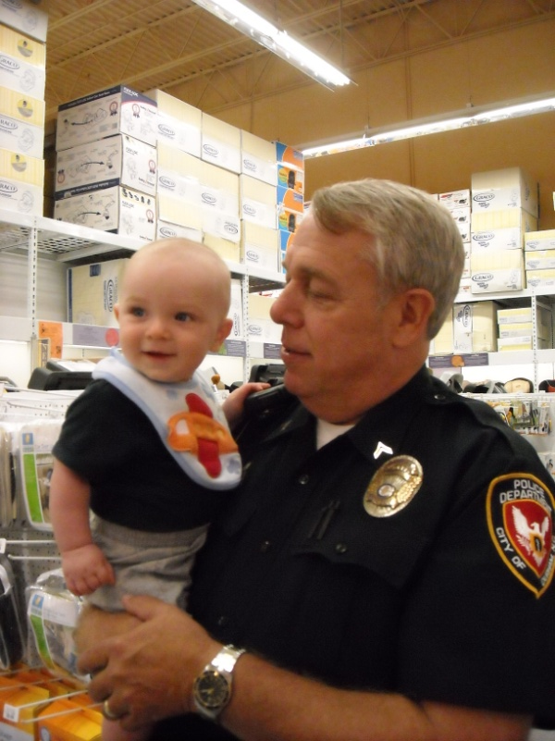
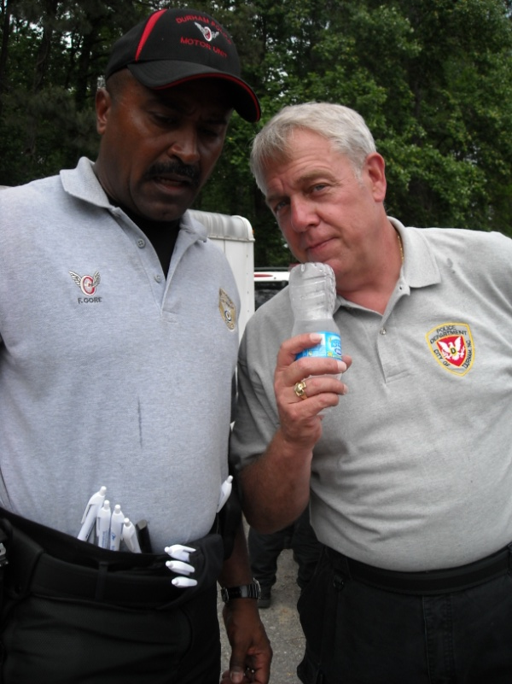
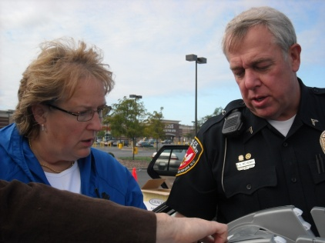
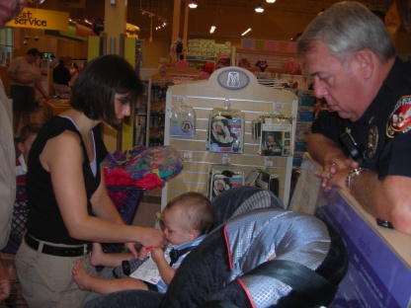
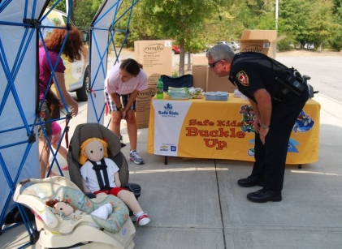
Bill Hall Lifetime Achievement Award
Stan McHenry, Durham Police Department

